Slide 1
SASolstice Advisory
KICKOFF & INVESTMENT REVIEW
Leadership Accelerator
Cohort 1.
A 12-week leadership-development program for our own team — prepared for the Executive Committee.
Prepared for the Executive Committee · October 2026
portal.solsticeadvisory.com

Slide 2
WHY NOW
Our best people are leaving before we invest in them.
Senior Associate voluntary attrition has averaged 18% a year over the past three years. Exit interviews point to one thing over and over: no clear path to grow into more responsibility before moving on.
What exit interviews tell us
No structured way to build people-leadership skills
No peer group going through it together
No visible path from Associate to Principal
Solstice Advisory
2 / 8

Slide 3
COHORT STRUCTURE
24 Associates. 8 peer triads. 6 modules.
One cohort, three offices, twelve weeks — async work, six live workshops, and a peer triad that meets every module.
24
8
6
12
Associates
Peer triads
Modules
Weeks
Solstice Advisory
3 / 8

Slide 4
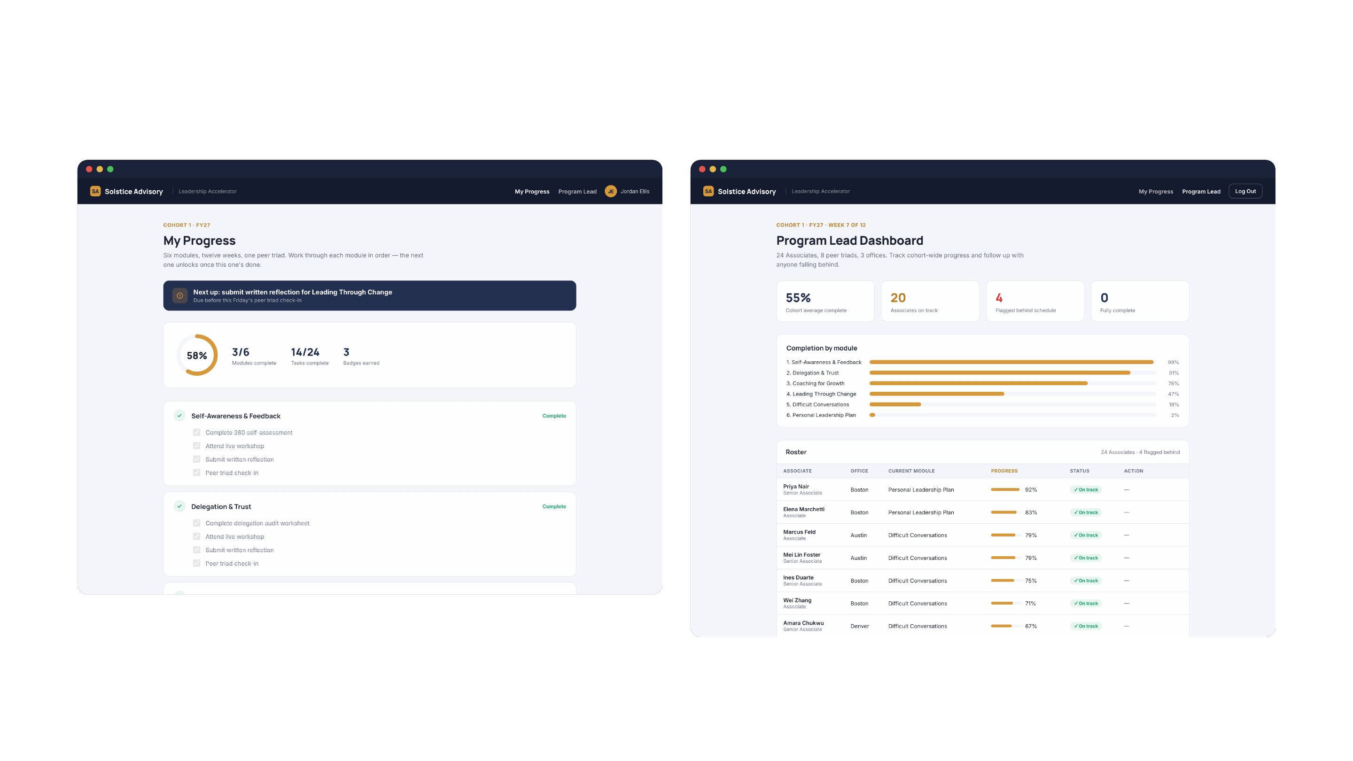
THE TOOLING
One portal, two views.
My Progress — every Associate's own checklist
Program Lead Dashboard — cohort-wide, live
Solstice Advisory
4 / 8

Slide 5

TIMELINE
Twelve weeks, six modules, two milestones.
Week 1
Weeks 2–6
Weeks 7–11
Week 12
Kickoff
Modules 1–3
Modules 4–6
Capstone
Whole cohort, in person
Self-awareness, delegation, coaching
Change, difficult conversations, plan
Showcase for sponsors
Each module: async pre-work, one live workshop, a written reflection, and a peer triad check-in — every Associate moves through the same six-week rhythm twice.
Solstice Advisory
5 / 8

Slide 6
BUDGET & ROI
$45,200 to build it. $184,320 in retention value.
Cohort 1 · from the program's own budget & ROI tracker
PROGRAM COST
PER PARTICIPANT
RETENTION VALUE
NET BENEFIT
ROI
$45,200
$1,883
$184K
$139K
308%
Year 1, projected
Year 1
Return multiple: 4.1x
Payback inside Year 1, on retention value alone
Solstice Advisory
6 / 8

Slide 7
THE ASK
What we're asking the Committee for.
01
02
03
Budget approval
Manager time
An exec sponsor
$45,200 for Cohort 1, inside this year's L&D line.
Release each Associate for ~3 hrs/week across the 12 weeks.
One Committee member to open kickoff and attend the capstone showcase.
Solstice Advisory
7 / 8

Slide 8
SASolstice Advisory
THANK YOU
Let’s build this leadership bench, together.
This month — approve budget and confirm exec sponsor
01
02
Next month — kickoff, Week 1
03
Ongoing — track progress live in the portal
people@solsticeadvisory.com
portal.solsticeadvisory.com

